Slide 1
Travelers | NESS 2022 Hackathon Competition
Theme 1: Customer Retention
Notes:
Rahul

Slide 2
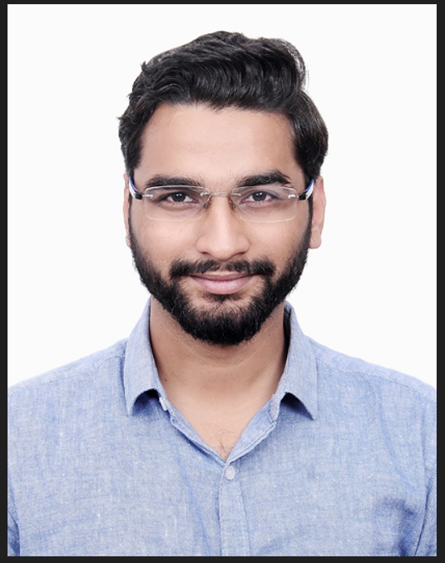
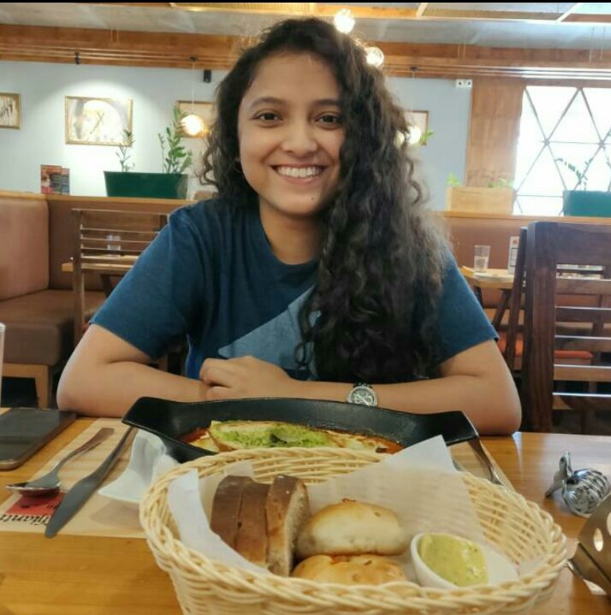
Team Introduction - Data Callers
Rahul Choubisa
University of Connecticut, MSBAPM
https://www.linkedin.com/in/rahul-choubisa-441a8841/
Juhi Choubey
University of Washington, MSDS
https://www.linkedin.com/in/juhi-choubey/
Notes:
Rahul

Slide 3
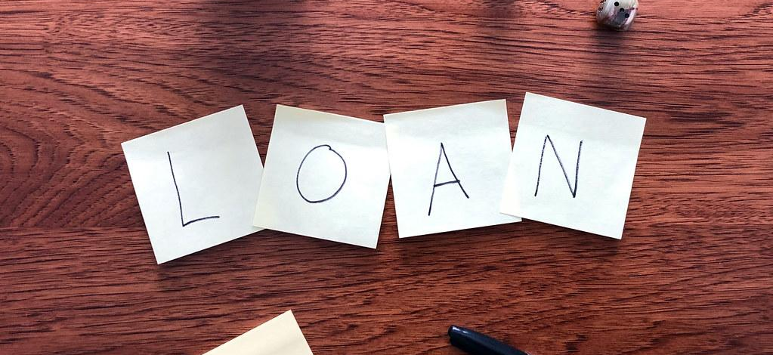



01
Customer Retention
Business Problem
The Issue: An American Company Kangaroo Auto Insurance is concerned about the company’s retention rates as well as the key drivers that cause policy cancellations. The business partner wants to create a retention model based on historical policy data.
Our Opportunity: With the help of a multiclass predictive model, Kangaroo Auto Insurance will be able to predict the policies that are most likely to be canceled and those most likely to be renewed, as well as understand what variables are most influential in causing a policy cancellation.
Notes:
Rahul

Slide 4
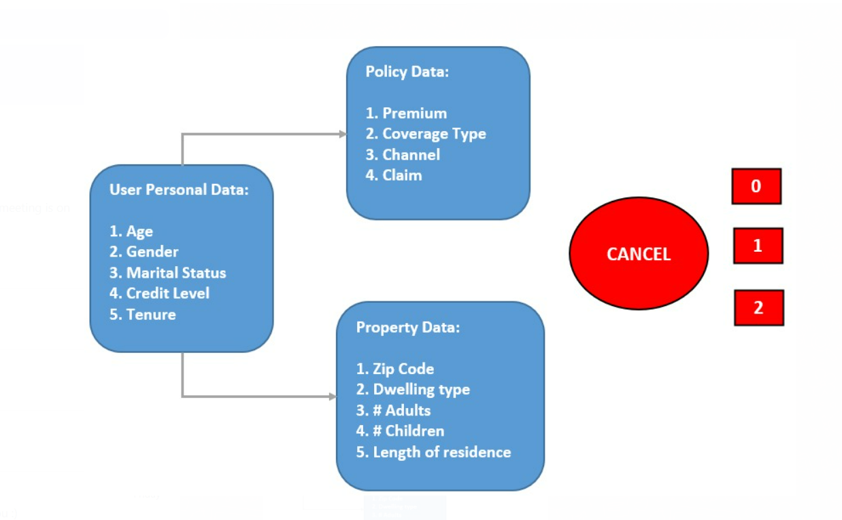
01
Dataset
Total Records: 1,048,575
Independent Features: 17
History: 2013 to 2017
Response: ‘Cancel’
0 = not cancel
1 = may cancel but can be convinced
2 = cancel
*Removed -1 from the response
Notes:
Rahul
House color was not considered and years data we have 2013 to 2017

Slide 5
01
Process Overview
Prediction & Strategy
Our Process
Model Analysis
The team identified three primary project objectives →
Experimental Design & Data Exploration
Notes:
Rahul
S - Sample E - Explore M - Modify M - Model A - Assess
Data Exploration -
Model

Slide 6
02
Experimental Design & Data Exploration
Notes:
Steph

Slide 7
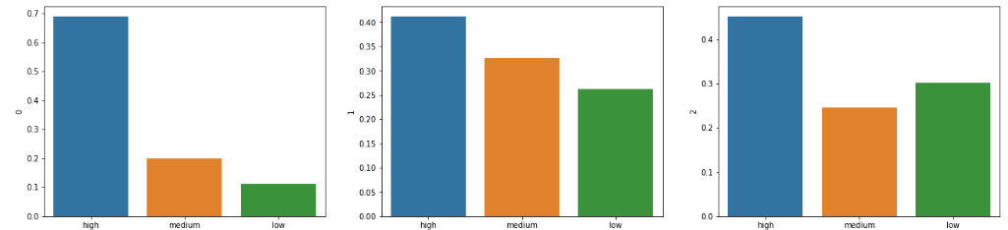
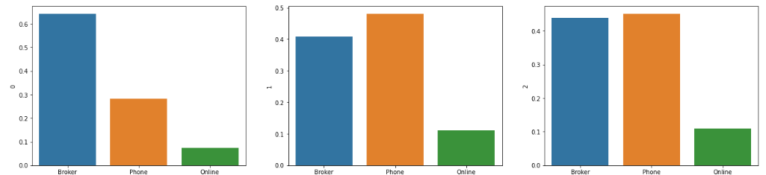
02
Data Exploration – Hypothesis Testing (1)
Categorical Features: Proportion across Response Categories
Credit
H₀: Rate of cancellation equal across credit levels
H_{a}: Rate of cancellation not equal in credit levels
Statistical Test: Chi-square test of independence
p-value: 0.0
Inference: Cancellation depends on credit level
+6M
—15M
+13M
Sales Channel
H₀: Rate of cancellation equal across sales channel
H_{a}: Rate of cancellation not equal in sales channel
Statistical Test: Chi-square test of independence
p-value: 0.0
Inference: Cancellation depends on sales channel
Notes:
Juhi
Credit, Claim, Coverage Type, Sales Channel, Dwelling Type, Year, Gender, Marital Status , House Color

Slide 8
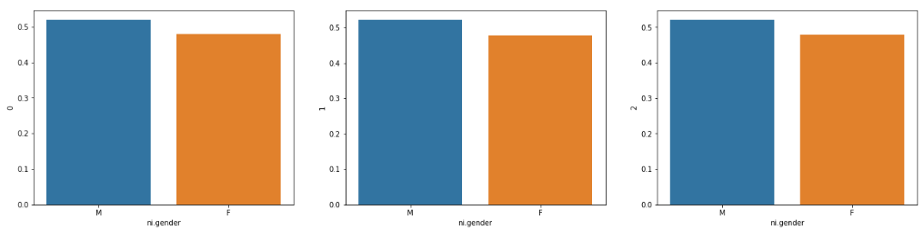
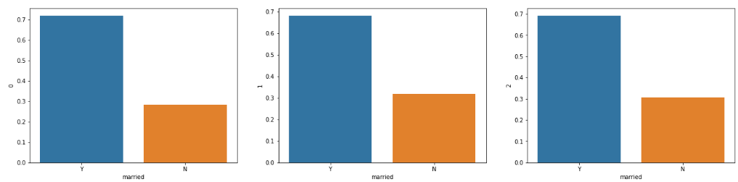
02
Data Exploration – Hypothesis Testing (2)
Categorical Features: Proportion across Response Categories
Gender
H₀: Rate of cancellation equal across genders
H_{a}: Rate of cancellation not equal across genders
Statistical Test: Chi-square test of independence
p-value: 0.336
Inference: Cancellation does not depend on gender
+6M
—15M
+13M
Martial Status
H₀: Rate of cancellation equal across marital status
H_{a}: Rate of cancellation not equal in marital status
Statistical Test: Chi-square test of independence
p-value: 0.0
Inference: Cancellation depends on sales channel
Notes:
Juhi
Credit, Claim, Coverage Type, Sales Channel, Dwelling Type, Year, Gender, Marital Status , House Color

Slide 9
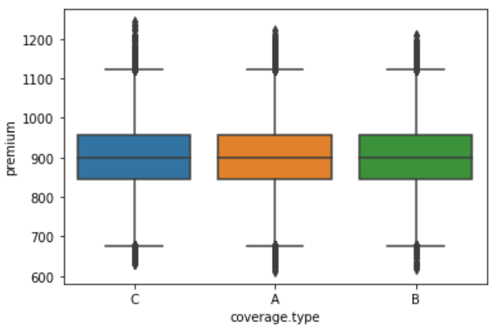
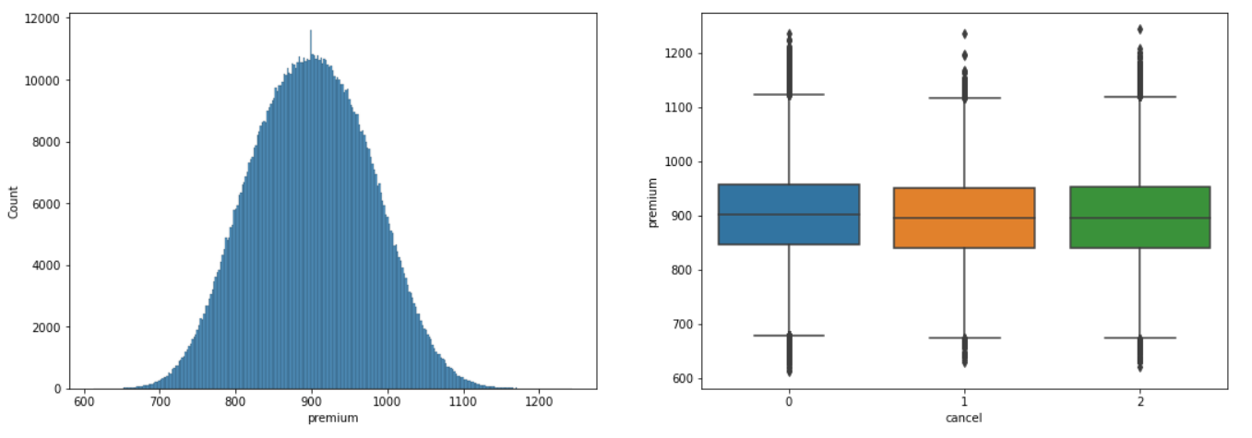
02
Data Exploration – Hypothesis Testing (3)
Numerical Features: Proportion across Response Categories
Premium
+6M
—15M
+13M
H₀: Mean premium equal across 3 classes of cancelation
H_{a}: Mean premium not equal across 3 classes of cancelation
Statistical Test: ANOVA
p-value: 0.02 (alpha = 0.01)
Inference: Mean premium equal in 3 classes of cancelation
Notes:
Juhi
Credit, Claim, Coverage Type, Sales Channel, Dwelling Type, Year, Gender, Marital Status , House Color

Slide 10
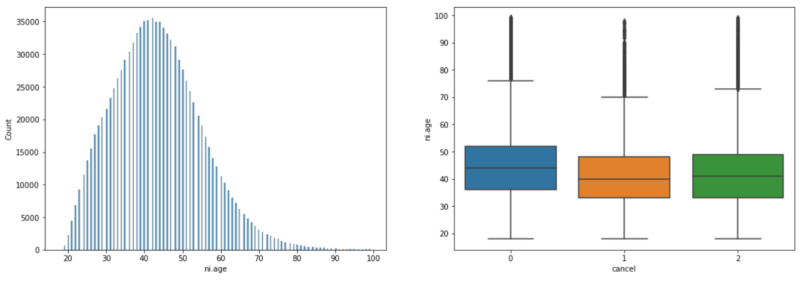
02
Data Exploration – Hypothesis Testing (3)
Numerical Features: Proportion across Response Categories
Premium
H₀: Mean premium equal across 3 classes of cancelation
H_{a}: Mean premium not equal across 3 classes of cancelation
Statistical Test: ANOVA
p-value: 0.02 (alpha = 0.01)
Inference: Mean premium equal in 3 classes of cancelation
+6M
—15M
+13M
Age
H₀: Mean Age equal across 3 classes of cancelation
H_{a}: Mean Age not equal across 3 classes of cancelation
Statistical Test: ANOVA
p-value: 0.00024
Inference: Mean Age not equal across 3 classes of cancelation
Notes:
Juhi
Credit, Claim, Coverage Type, Sales Channel, Dwelling Type, Year, Gender, Marital Status , House Color

Slide 11
02
Data Exploration – Feature Extraction
Missing values Treatment
Response variable: Cancel
Removed ‘-1’ as it does not have any Business Definition (3452 records were dropped from training set)
Explanatory/Predictor Variables:
Categorical: Imputed using Mode
Numerical: Imputed using Median (to avoid shift in mean due to outliers)
Feature Engineering
Low Level Zone | High Level Zone
98xxx | 98
15xxx | 15
50xxx | 50
20xxx | 20
80xxx | 80
85xxx | 85
Age Bucket
1-25
25-35
35-45
45-60
>=60
Children
0
1-3
>3
Adults
0
1-2
>2
Notes:
Rahul

Slide 12
03
Model Analysis

Slide 13
03
Model Analysis – Base v/s Ensemble
Algorithms | Models | Cross-Validation | Accuracy | Precision
Base Linear Classification | Multi - Logistic regression (OVR) | Validation Set (80-20 Split) | 0.7247 | 0.6516
Base Linear Classification II | Discriminant Analysis – Linear | Test | 0.7234 | 0.6497
Non-Linear Classification | Discriminant Analysis – Quadratic | Test | 0.6927 | 0.6737
 | Naive Bayes | Test | 0.6932 | 0.6385
Regression Trees | Decision tree (Cost Complexity Pruning applied) | Test | 0.7199 | 0.6420
Ensemble Improvements | Random forest (Ensemble of 100 decision trees) | Test | 0.7054 | 0.6664
 | XG-Boost (Ensemble & Gradient Boosting) | Test | 0.7249 | 0.6756
By performing model averaging to create an ensemble model, we improved our previous models which is reflected in the new Accuracy and Precision rate.
Notes:
Juhi

Slide 14
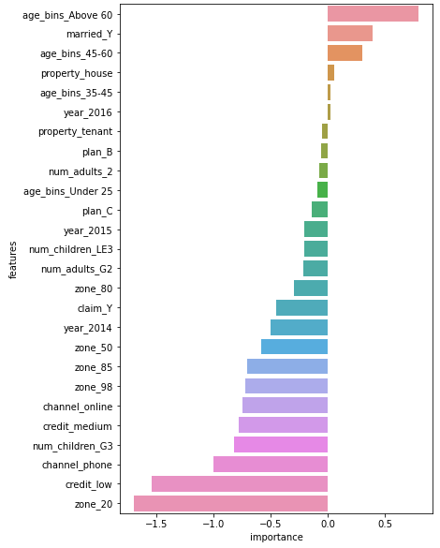
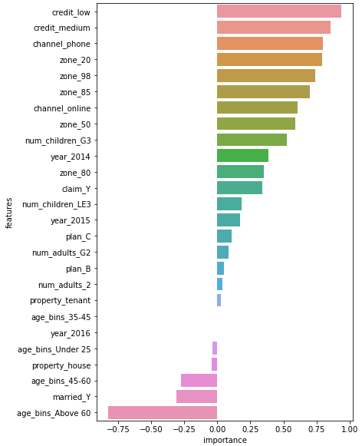
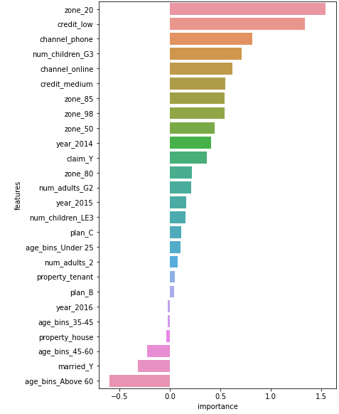
03
Model Analysis – Feature Importance
Retaining Policy Holders
May Cancel Policy Holders
Cancelling Policy Holders
Notes:
Juhi

Slide 15
04
Conclusion

Slide 16
Conclusion
03
High Risk
XG-Boost is the dataset’s most reliable model
Accuracy on cross-validated test data: 72.49%
Precision on cross-validated test data: 67.56%
Final Accuracy: 68.85%
Important Learnings & Company’s Next Steps
People residing in zone 20 with a low or medium credit score are at the highest risk of canceling the policy. Zone 20 people can have special attention and need to revisit the policy type according to their needs.
The preferred channel of the high-risk policyholder is phone or online. A potential suggestion can be reached out to them via alternated channel - broker.
Zone 20
Credit Low/Medium
Channel Phone/ Online
Married
Property House
Low
Risk
Age >60
Notes:
Rahul

Slide 17
Questions?

